Slide 1


Major League Baseball Statistics
Group 4:
Wade Strain, Xiaohui Ling, Omar Hanley, Andrew Picciano

Slide 2
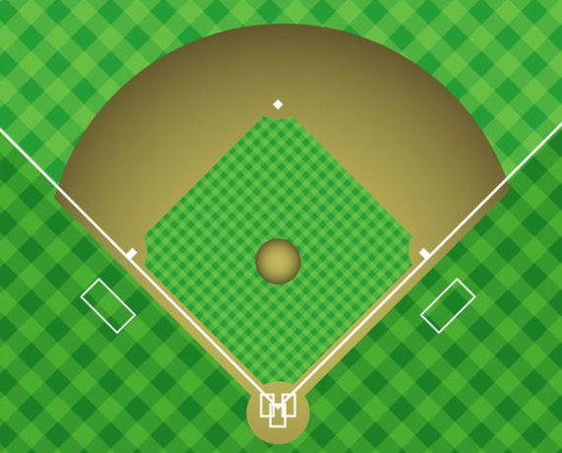
Agenda
Dimensional Model
ETL Process
Insights
Introduction
Data Acquisition
Lessons Learned
Notes:
The Agenda for today will be:
Introduction to show where we are going and explain our motivations behind this project
Data Acquisition process
Dimensional Model
ETL Process
Insights
Lessons Learned

Slide 3
Introduction
The best performing sports organizations are the ones that are leveraging technology to gain competitive advantages both on and off the field
A large part of that process is acquiring statistical information that is (for the most part) freely available on websites such as:
MLB.com
ESPN.com
Baseball-reference.com
Purpose: Replicate job responsibilities of a sports Business Intelligence department:
Gathering unstructured web data
Cleaning it
Create an ETL process
Using Tableau to visualize it
Notes:
Industries across the board are using data and technology to gain competitive advantages. We wanted to show to future employers that we can do this process.

Slide 4

Baseball Statistics
Attendance
Wins
AB -> At-bats
GP -> Games Played
R -> Runs
HR -> Home Runs
RBI -> Runs Batted In by a hitter
AVG -> Hits / At-Bats
OBP -> Times Reached / Plate Appearances
SLG -> Total Bases / At-Bats

Slide 5
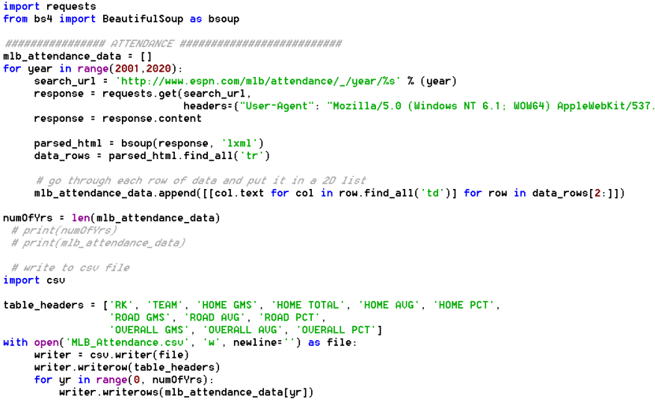
Data Acquisition via Web Scraping
Notes:
Web scraped the data using Python and BeautifulSoup. Gave it a website template and just changed the year in a for loop. Found each row in the table we wanted and and outputted it into a CSV file.

Slide 6
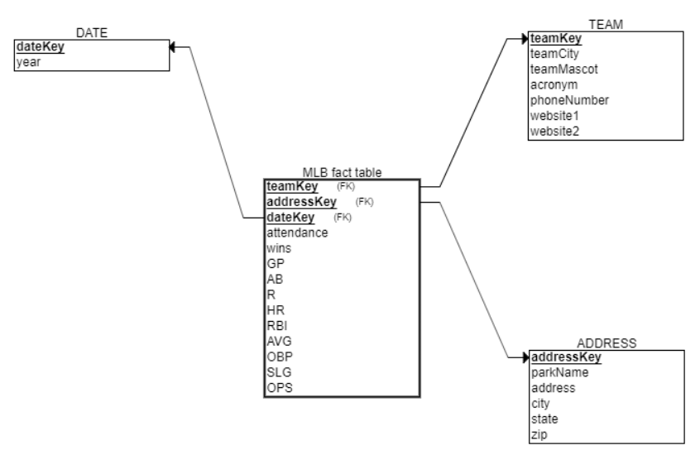
Dimensional Model
Notes:
Our dimensional model in ERD Plus.

Slide 7
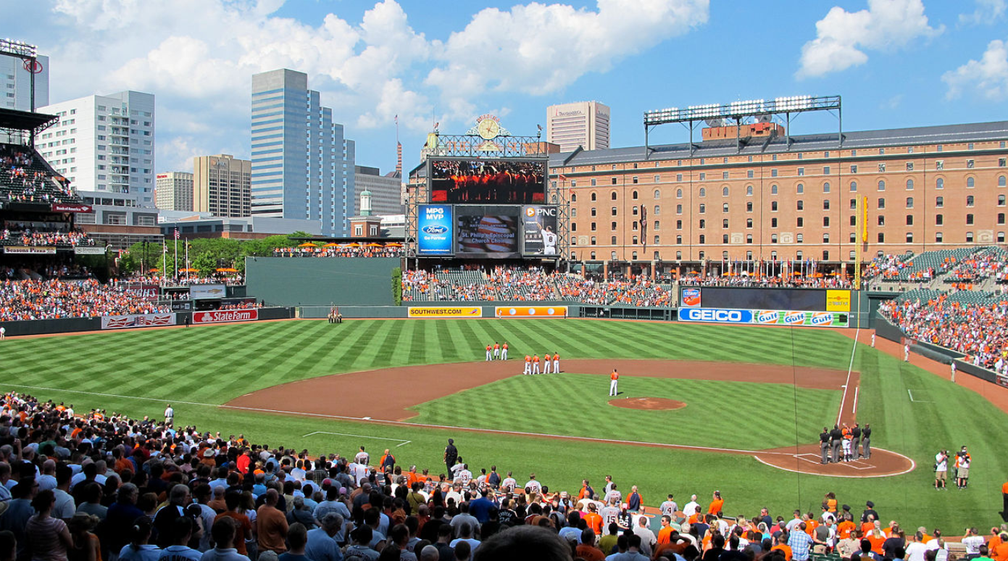
ETL Process

Slide 8
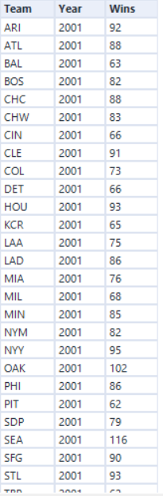
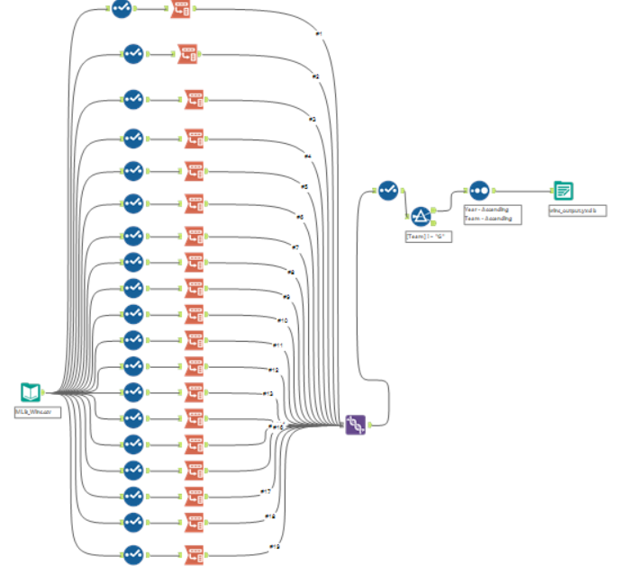
Wins Data Cleaning
Transforming column data to row level data is harder than you think…
RAW DATA
FORMAT…
OUTPUT
Notes:
Transforming the column level data, which is by year into row level detail. We want to make the matrix transform from a wide and short matrix into a narrow and long matrix with the data. We did this using Transform from each column 19 times. There was an easier way to do that in R...

Slide 9
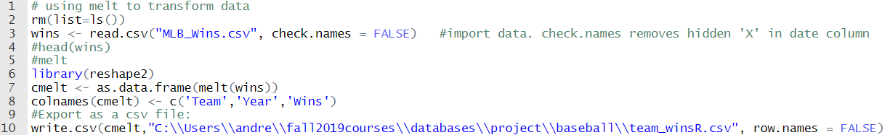
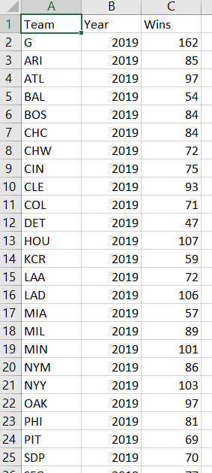
Wins Cont.
Or is it?
Notes:
With 5 lines of code, I was able to do the same thing in R.

Slide 10
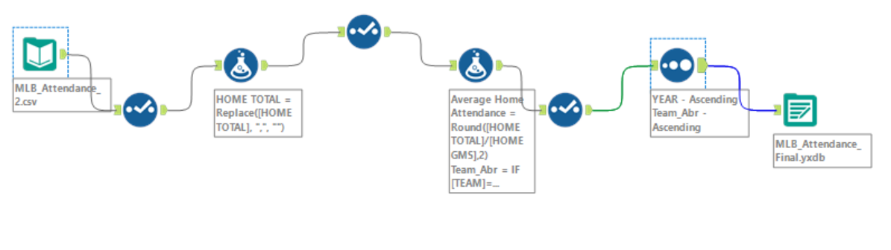
Attendance Data Cleaning
Formula tool:
Avg Home Attendance → Home Total/Home Gms
Team_Abr → Ex: “Baltimore Orioles” : BAL
Notes:
Omar:
Looked at home attendance, had to figure out what data to focus on. Made formulas for Avg Home Attendance, and Team Abr.

Slide 11
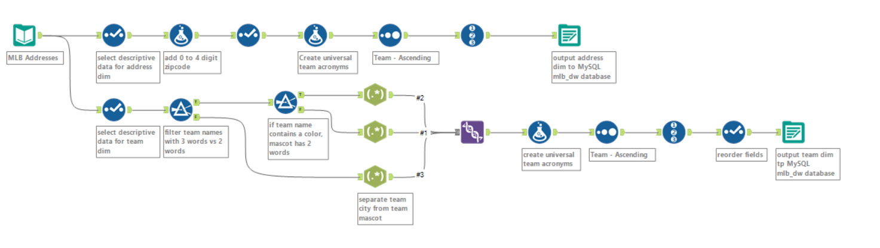
Address/Team Dimension
Formula tool: 4 digit zip code → 5 digit zip code
Filter & Regex tool: Parse team mascot and team name
Notes:
First, we noticed that some zip code only has four digits but other zip codes have 5 digits. So we first change the data type to a string and add a 0 to 4 digit zip code.
Also, the team name and mascot comes in one string. So we applied a regex tool to parse the team mascot and team name.

Slide 12
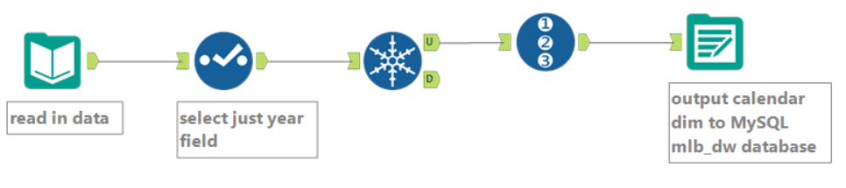
Calendar Dimension
Selecting unique Year from wins datasource
Granularity of data on a yearly level
Notes:
Used the wins dimension to select the unique year since our time series granularity only goes to the year level.

Slide 13
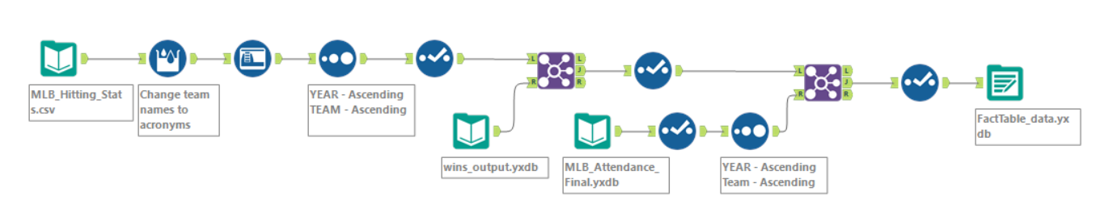
Fact Table Data Prep
Changed team names into acronyms
Joined data from three different sources
Notes:
Made sure each file has a universal team acronym so that we could join the different data tables into one fact table.

Slide 14
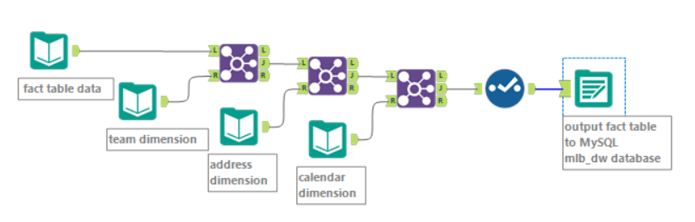
Fact Table
Notes:
Joined the dimensions to the fact table using foreign keys in the fact table

Slide 15
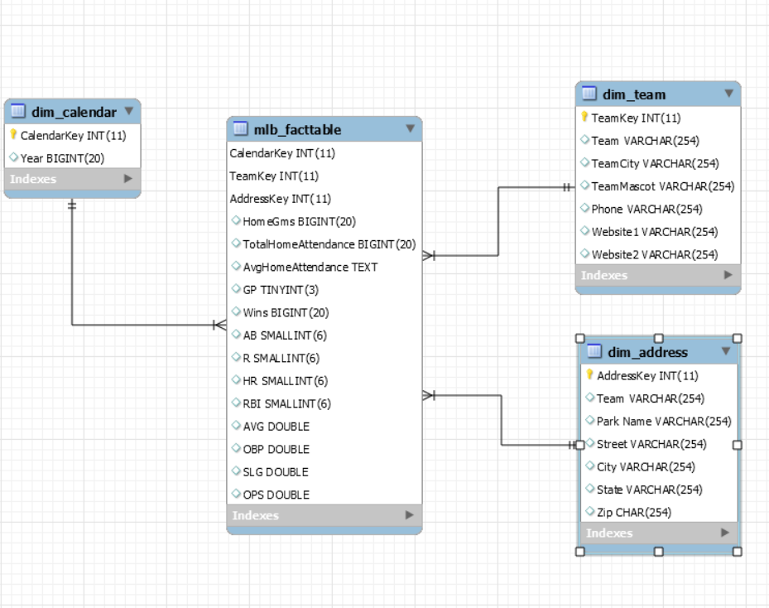
Schema Diagram from MySQL
Notes:
Looks the same as a our drawn up diagram earlier in the presentation

Slide 16
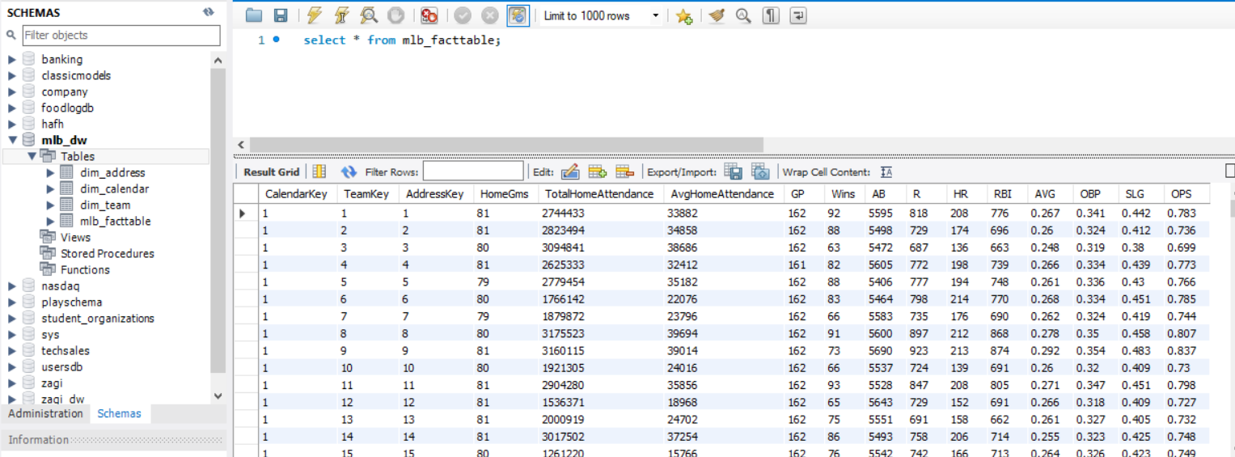
Fact Table in MySQL
Notes:
Our fact table in MySQL from our data warehouse

Slide 17
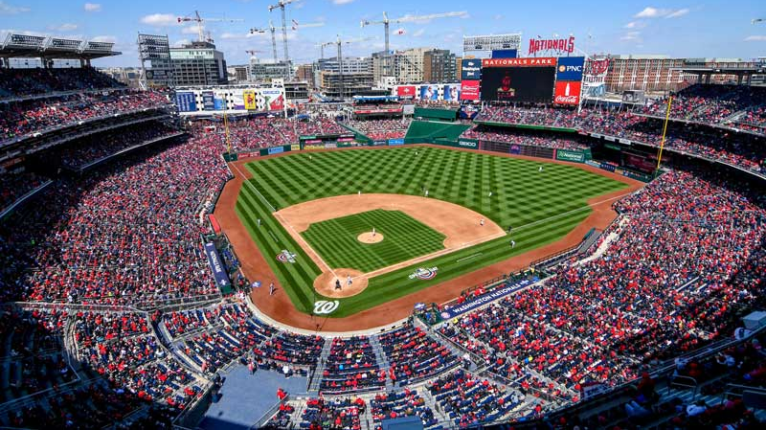
Insights

Slide 18
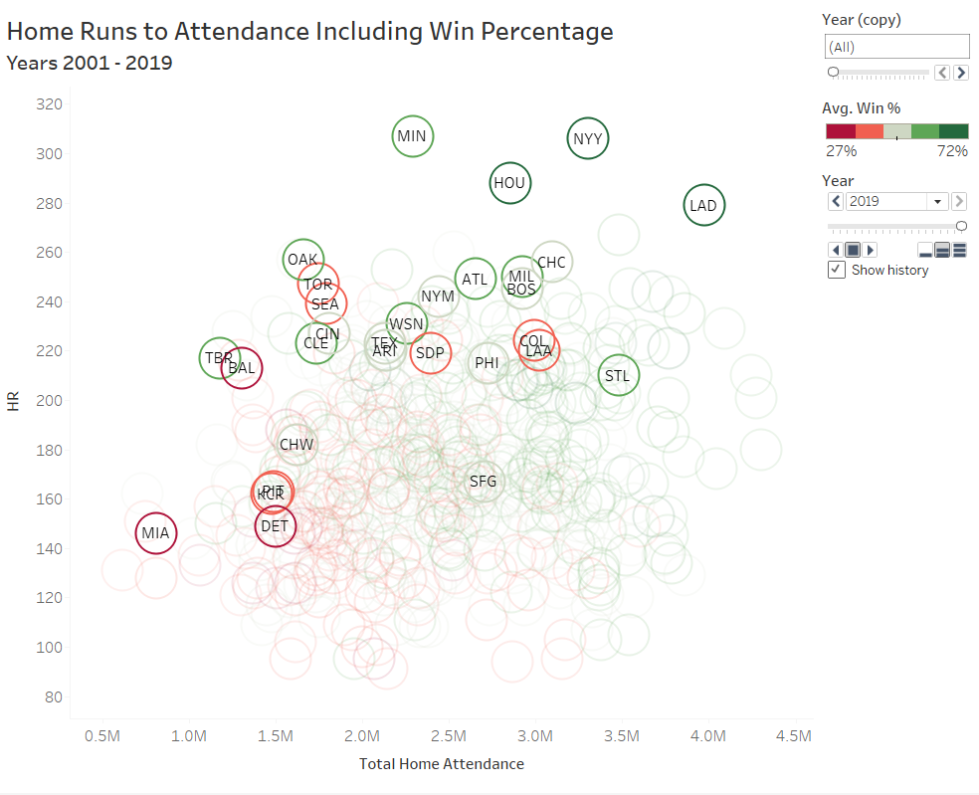
Spike in Home Runs in 2019
Belief that baseballs were
“juiced” in 2019
Full animation at:
https://public.tableau.com/profile/drewstr7#!/vizhome/baseball_viz-HRtoAttendance/HRtoAttendance_Win_Animation
Notes:
Looking at Home Runs in 2019 versus prior years. Media reports suggested that the baseballs were being “juiced” or altered in a way so that Home Runs would occur more frequently. This animation runs from 2001 to 2019. The faded circles are years 2001-2018. The chart indicates there was a significant jump and increase over time, with 2019 standing out the most.
This full animation is available in our Tableau Public portfolio: https://public.tableau.com/profile/drewstr7#!/vizhome/baseball_viz-HRtoAttendanceAnimation/HRtoAttendanceAnimation

Slide 19
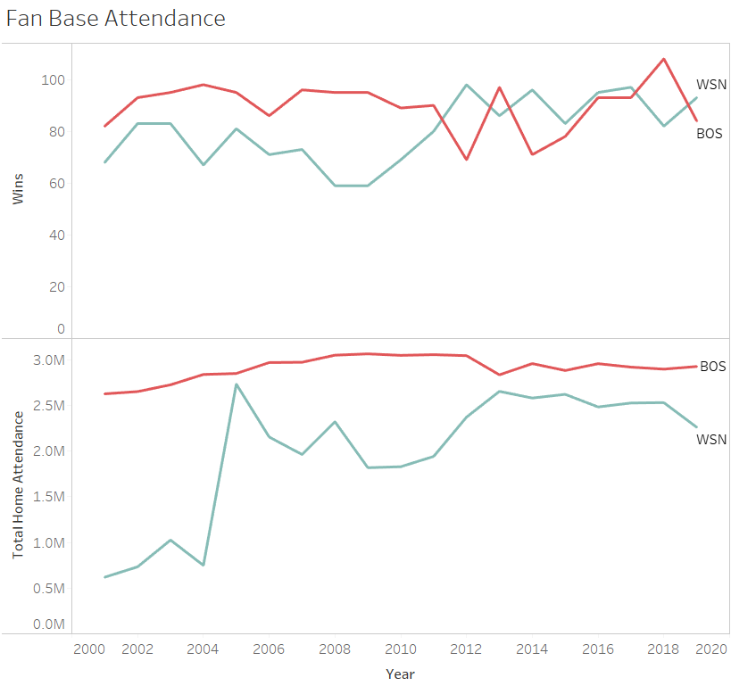
Bragging Rights
Red Sox
Stronger brand
More loyalty
Low variance
Nationals
New team
Higher variance
Higher correlation between attendance and wins
Notes:
Looked at trends between Wins and Home Attendance. Could see more loyalty and lower variance for Red Sox vs Higher variance and higher correlation with the Nationals.
The first spike in Attendance for the Nationals was due to them moving to Washington DC from Montreal that year

Slide 20
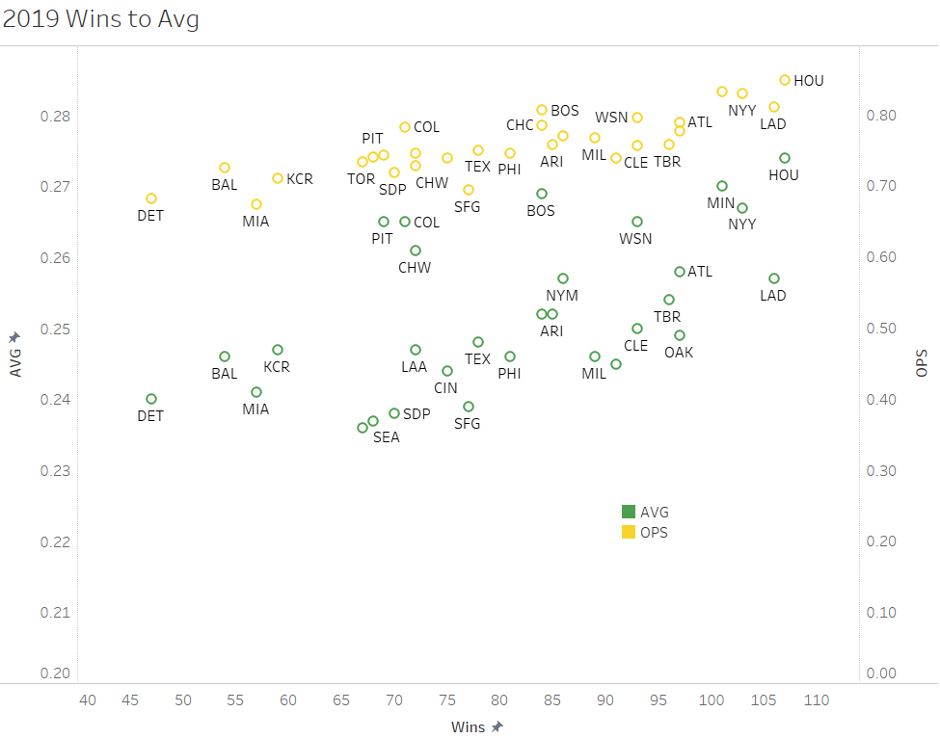
OPS vs. AVG
OPS (On-base Plus Slugging Percentage)
Positive linear trend between wins & AVG and wins & OPS
Some outliers for AVG (high AVG, but low wins)
Bad pitching as possible reason
Notes:
As Avg goes up, the wins go up; as ops goes up, the wins goes up too.
OPS is pretty linear; (But green line(Pittsburgh and Boston, chicago white socks) has some outliers: which means these team have high average but not so many wins: poor pitching ; offense is good, defense is not that good.

Slide 21
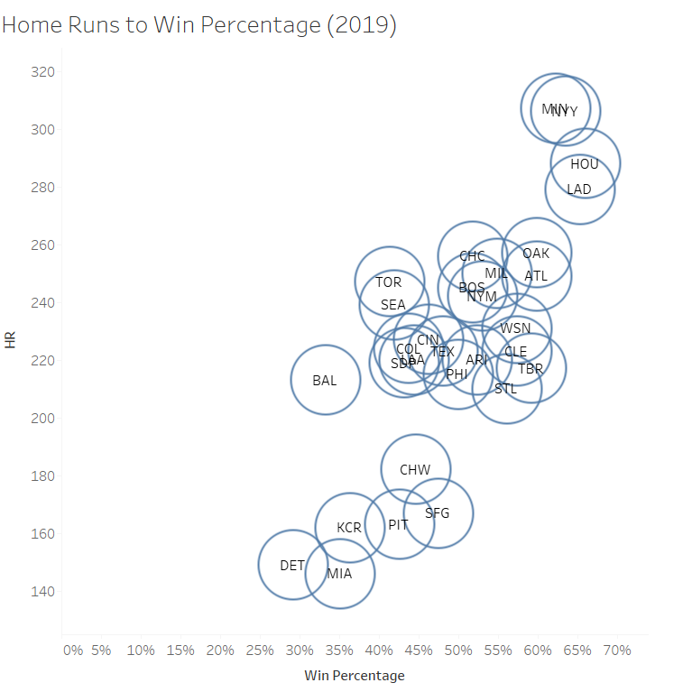
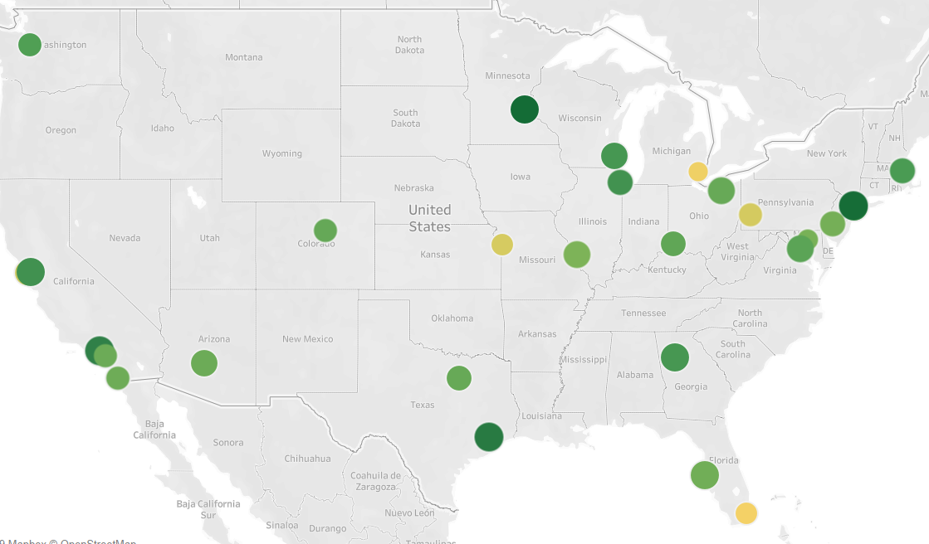
Home Runs To Win Percentage
Notes:
for map: size is win %, color is # of HRs.
This was for fun and just playing around with alteryx.
We know that geography doesn’t help explain the data, but we wanted to see if our address data worked in Alteryx

Slide 22
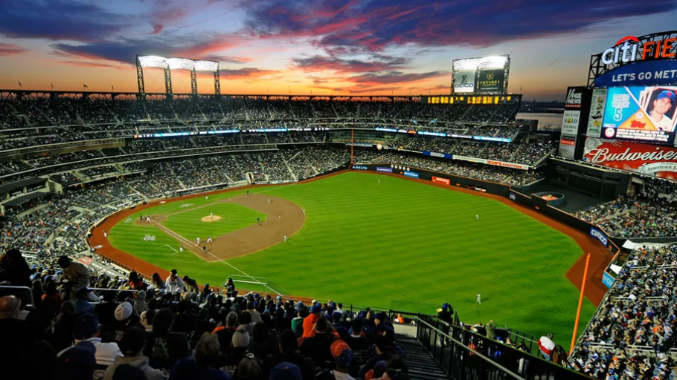
Lessons Learned

Slide 23
Lessons Learned
Easiest Steps
Data Acquisition
Calendar dimension
Creating data visualizations
Difficulties
Learning a new software (Alteryx)
Data Cleansing
Key Takeaways
Don’t rely too heavily on one software
Documentation of Alteryx and following steps
Improvements for Indicators
Find cleaner data
Pitching Statistics
Incorporate stadium size to show attendance percentage
Notes:
Tableau was easy because our data was clean, pretty sure it would not be so easy if our data was all over the place.
We want to continue our analysis and implement it so that we can update it regularly and incorporate pitching, stadium size, and individual data.

